Slide 1
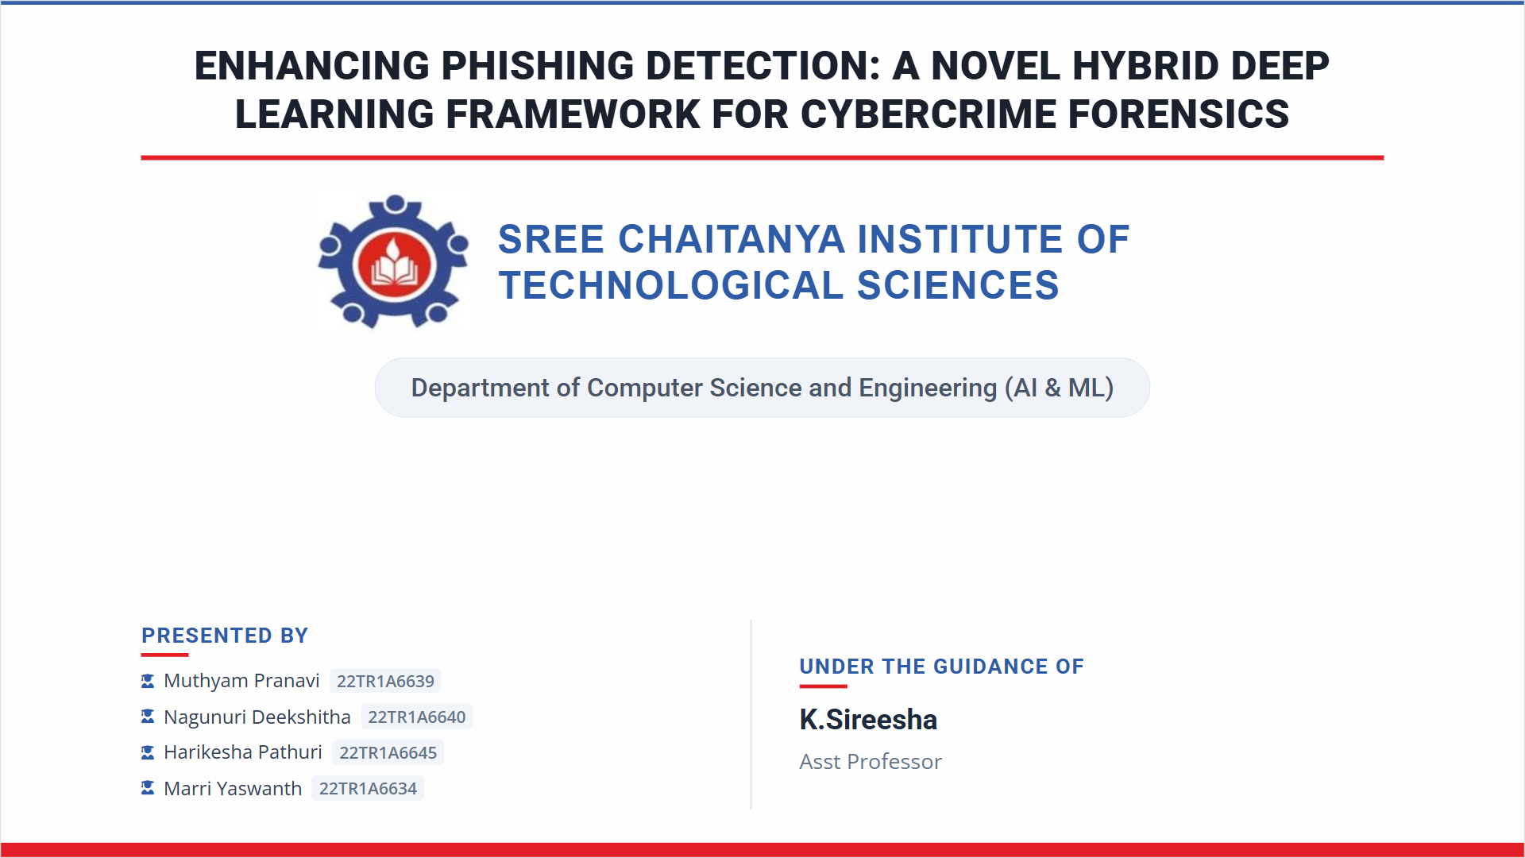

Slide 2
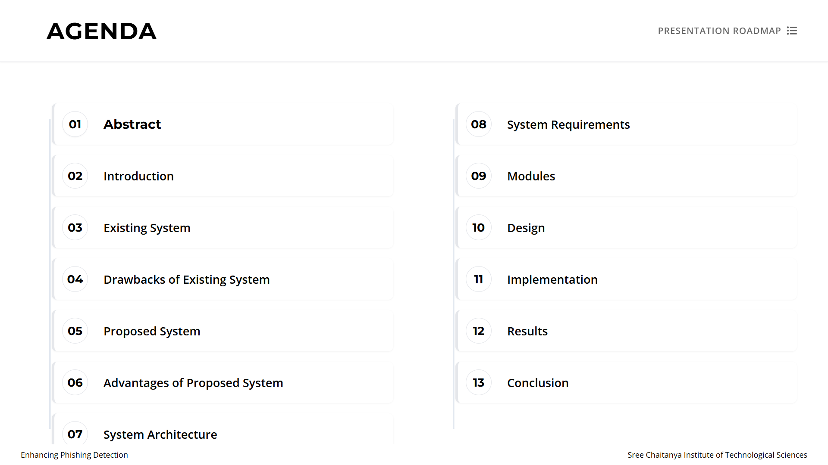

Slide 3
Abstract
Phishing attacks are one of the most common cyber threats targeting internet users.
Attackers create fake websites or emails to steal sensitive information such as passwords, banking credentials, and personal data.
This project proposes a Hybrid Deep Learning Framework to improve phishing website detection.
The system analyzes website features and uses deep learning models to classify websites as phishing or legitimate.
The proposed system aims to achieve higher accuracy and reduced false positives.

Slide 4
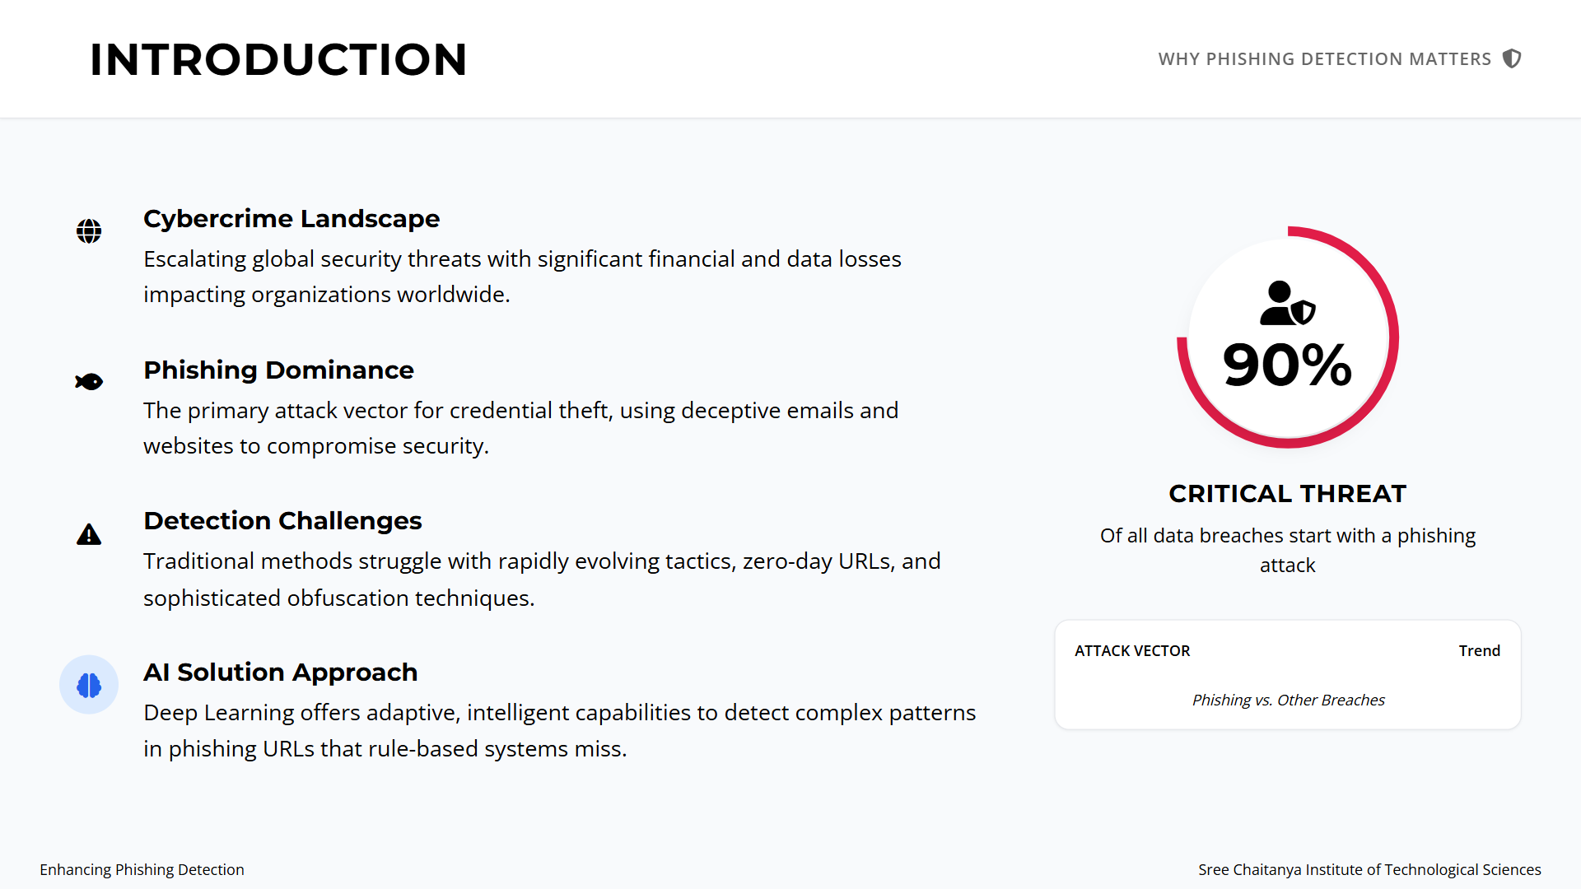
Introduction

Slide 5
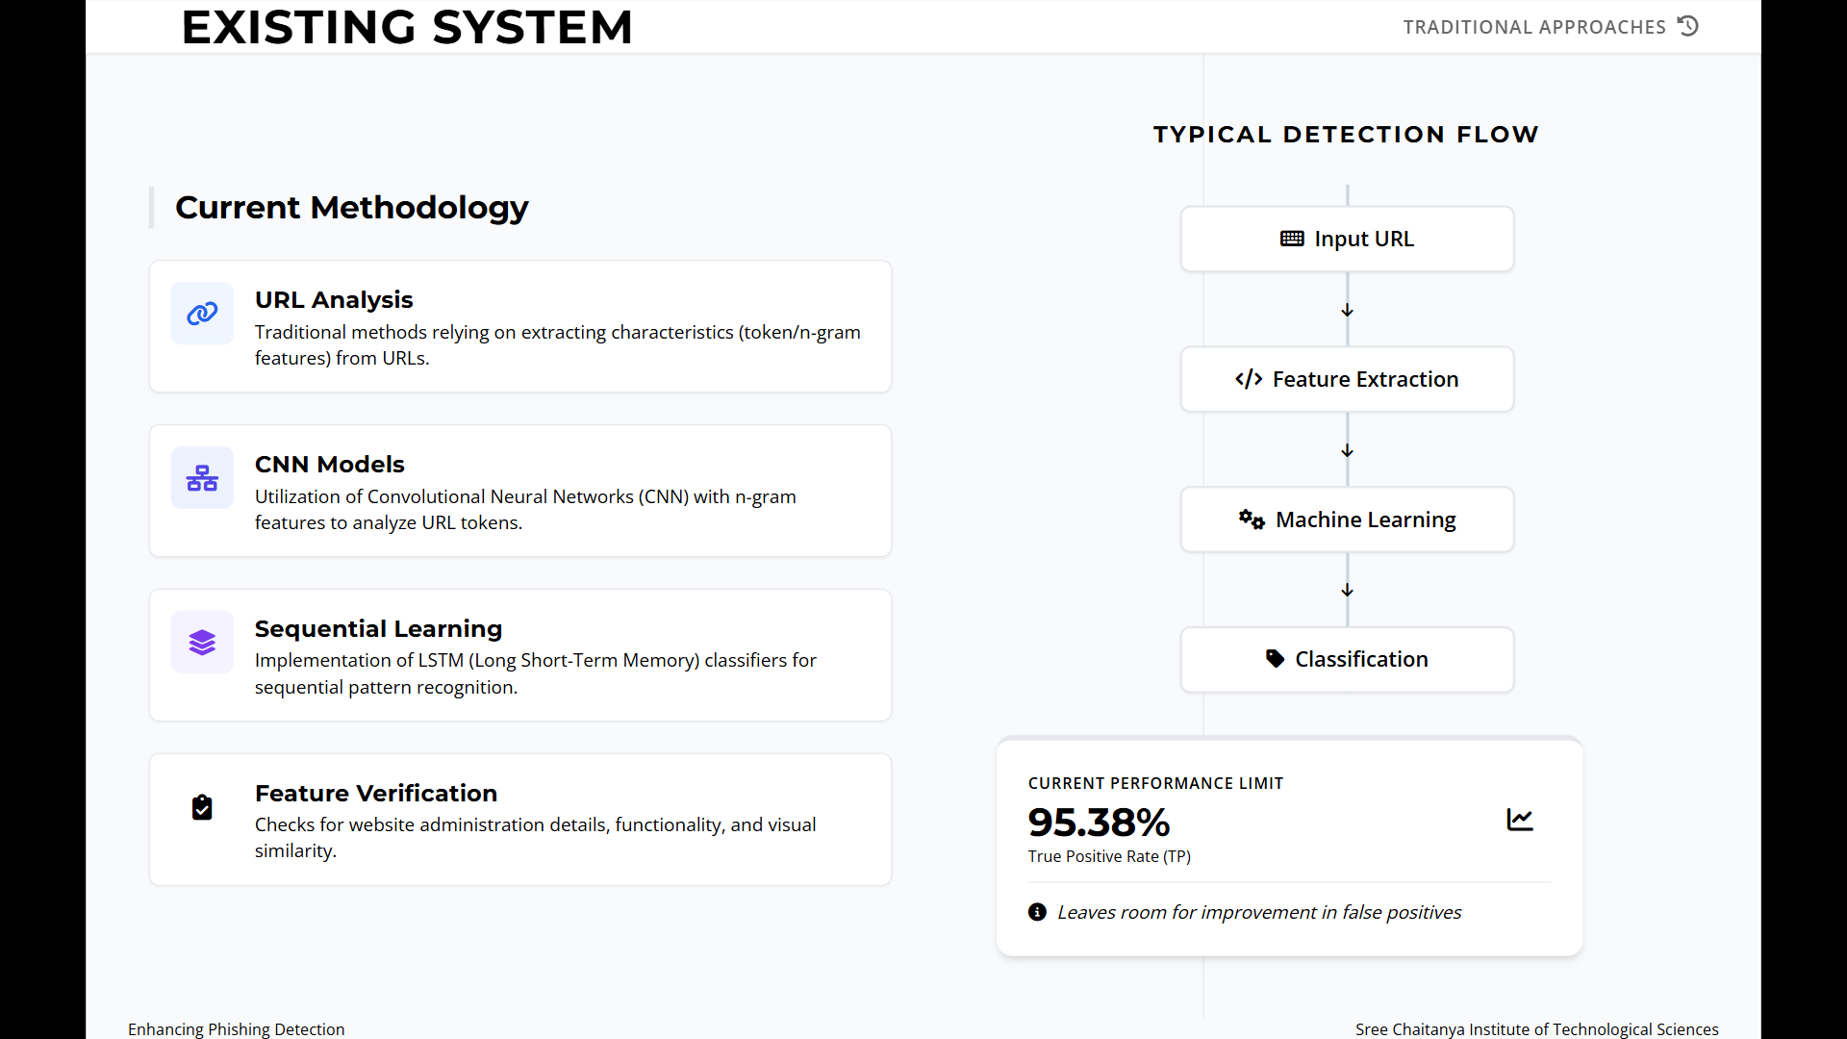

Slide 6
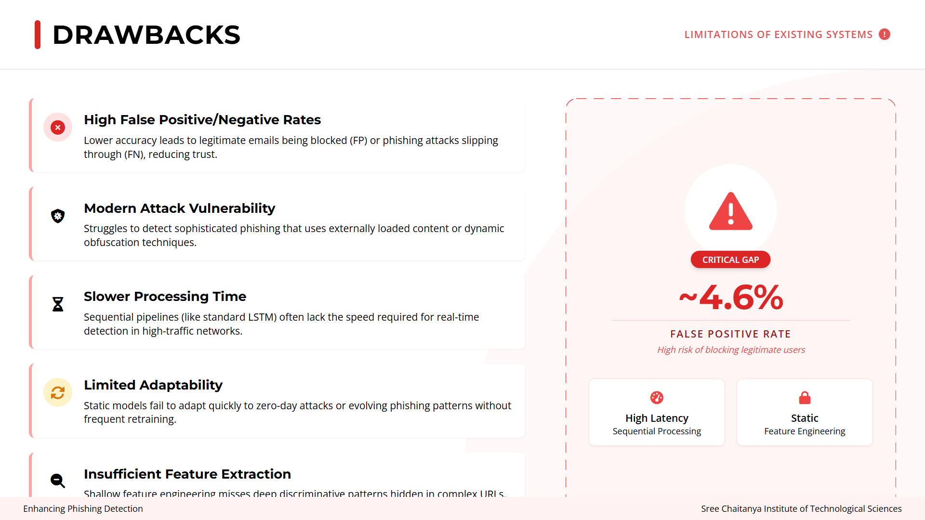

Slide 7
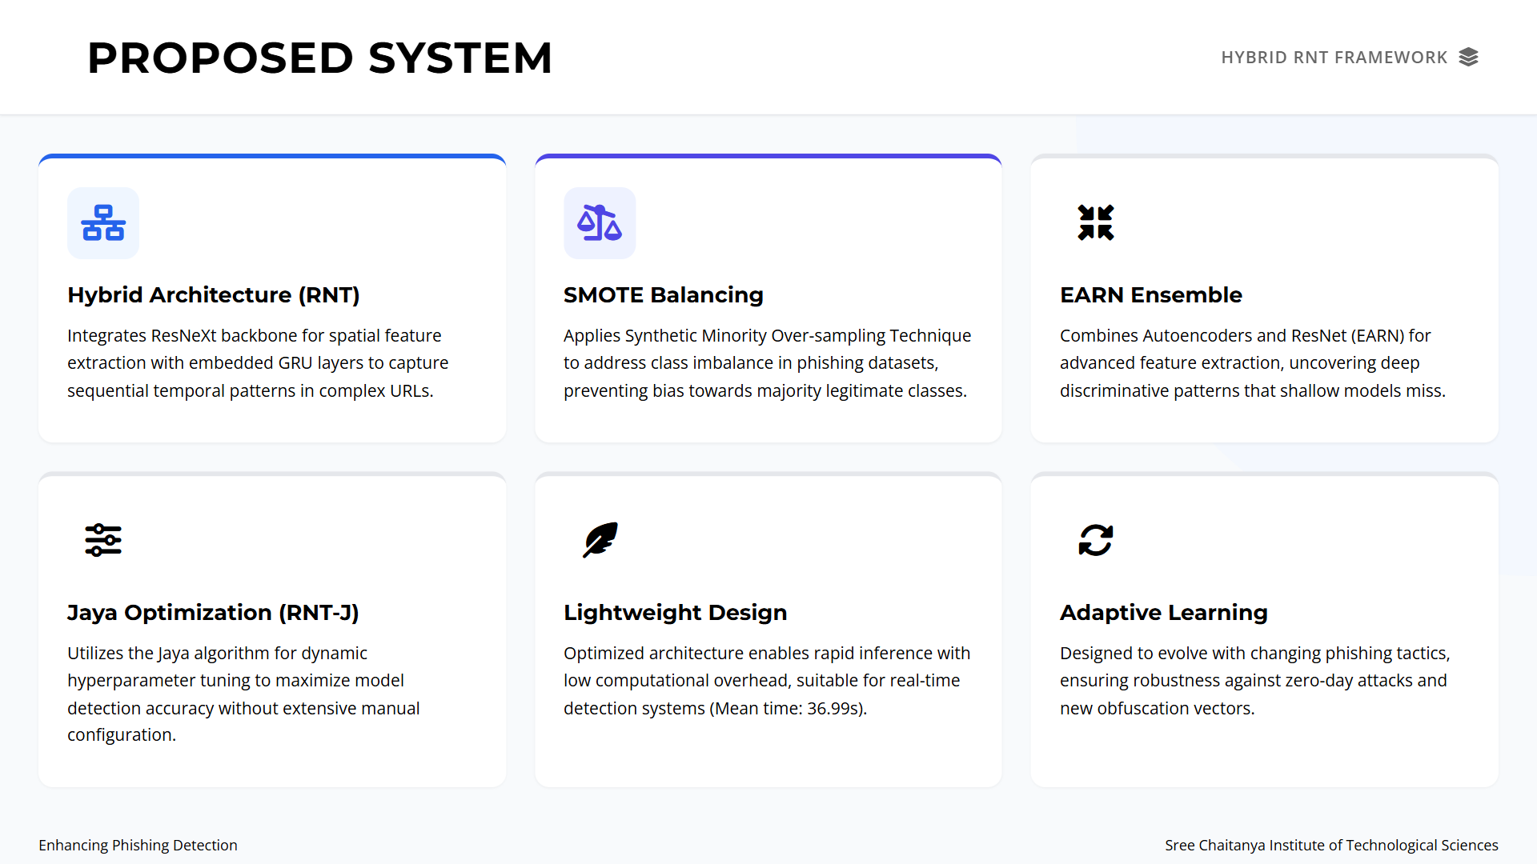

Slide 8
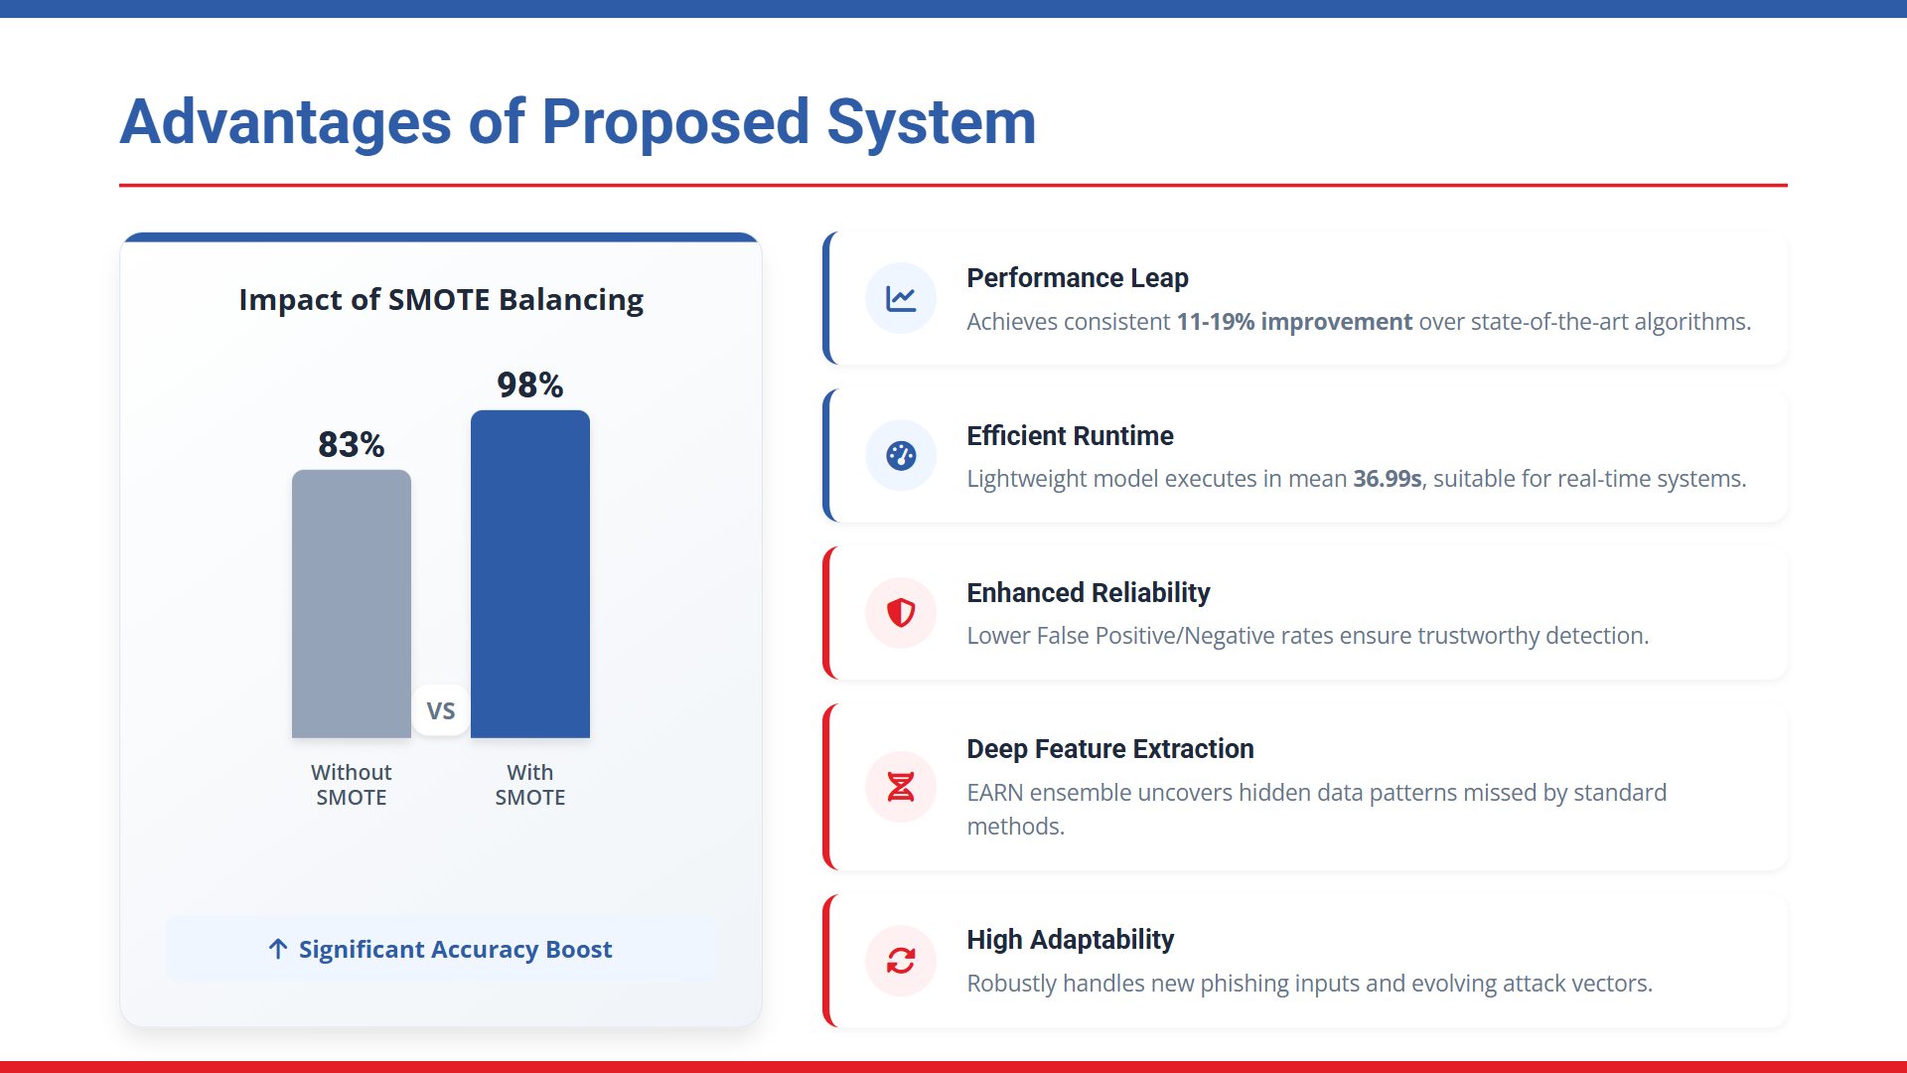

Slide 9
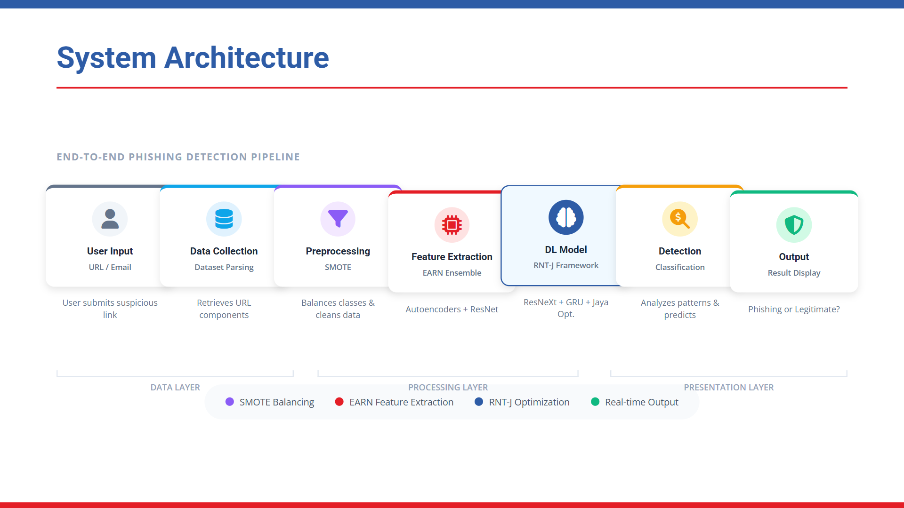

Slide 10


Slide 11


Slide 12
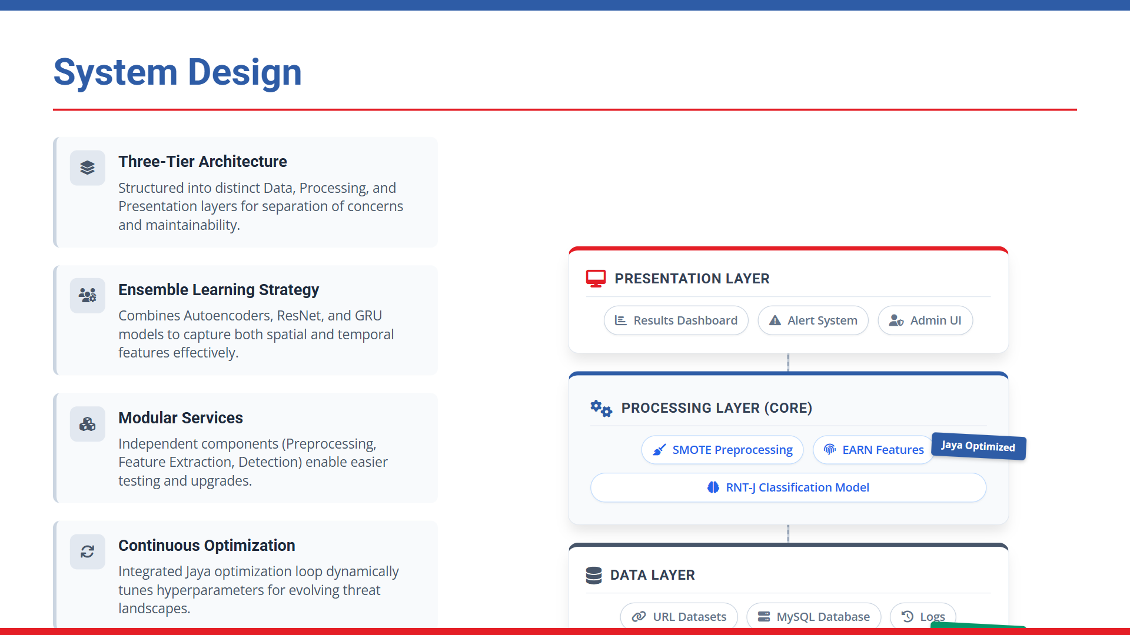

Slide 13
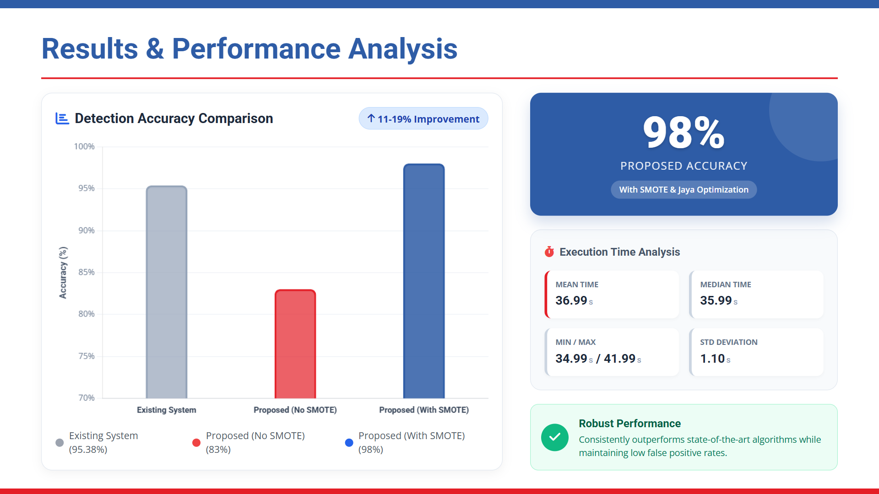

Slide 14
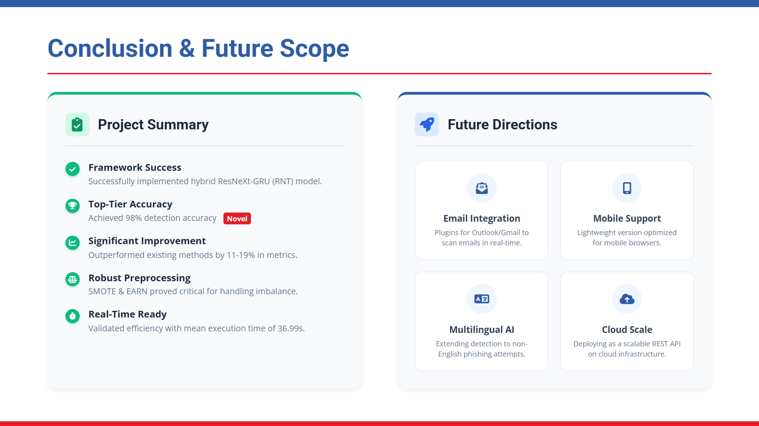

Slide 15
THANK YOU

